Slide 1
Chapter 6: User-Defined Functions

Slide 2
User-Defined Functions
Introduction
Function Definition
Void function
Global Vs Local variables
Random Number Generator
Recursion
Function Overloading
Sample Code

Slide 3
Objectives
In this chapter, you will:
Learn about standard (predefined) functions
Learn about user-defined functions
Examine value-returning functions
Construct and use a value-returning, user-defined function
Construct and use void functions
Understand value and reference parameters

Slide 4
Objectives (cont’d.)
In this chapter, you will (cont’d.):
Learn about the scope of identifiers
Understand local and global identifiers
Learn about static variables
Debug programs using drivers and stubs
Learn about function overloading
Explore functions with default parameters

Slide 5
Introduction
Functions are often called modules
They are like miniature programs that can be combined to form larger programs
They allow complicated programs to be divided into manageable pieces

Slide 6
Predefined Functions
In C++, a function is similar to that of a function in algebra
It has a name
It does some computation
Some of the predefined mathematical functions are:
sqrt(x)
pow(x, y)
floor(x)

Slide 7
Predefined Mathematical Functions (Built-in Function)
Function Exponentiation
pow (x, y) x is raised to power y; (x^{y} )
sqrt (x) Square-root of x
sin (x) Sine of x
cos (x) Cosine of x
tan (x) Tangent of x
exp (x) Exponentiation of x, ( e^{x})
fabs (x) Absolute Value of x, | x |
log (x) Logarithm of x (base e)
log10 (x) Logarithm of x (base 10)
floor (x) Rounding-down x
ceil (x) Rounding-up x
Eg.1. floor (9.2) = 9.0 Eg.2. floor (-9.8) = -10.0
You need to include <math.h> to be able to use these functions.
In newer versions it is #include<cmath>

Slide 8
Predefined Functions (cont'd.)
Predefined functions are organized into separate libraries
I/O functions are in iostream header
Math functions are in cmath header
To use predefined functions, you must include the header file using an include statement

Slide 9
Functions in C++
Experience has shown that the best way to develop and maintain large programs is to construct it from smaller pieces(Modules)
This technique Called “Divide and Conquer”
Wise Development Approach
Bad Development Approach
main()
{
-----
----
}
function f1()
{
---
---
}
function f2()
{
---
---
}
main()
{
-----
-----
-----
-----
.
.
.
----
-----
-----
Return 0;
}
Easer To
Design
Build
Debug
Extend
Modify
Understand
Reuse
Better Organization

Slide 10
User-Defined Functions
Value-returning functions: have a return type
Return a value of a specific data type using the return statement
Void functions: do not have a return type
Do not use a return statement to return a value

Slide 11
Value-Returning Functions
To use these functions, you must:
Include the appropriate header file in your program using the include statement
Know the following items:
Name of the function
Number of parameters, if any
Data type of each parameter
Data type of the value returned: called the type of the function

Slide 12
Value-Returning Functions (cont’d.)
Can use the value returned by a value-returning function by:
Saving it for further calculation
Using it in some calculation
Printing it
A value-returning function is used in an assignment or in an output statement

Slide 13
Value-Returning Functions (cont’d.)
Heading (or function header): first line of the function
Example: int abs(int number)
Formal parameter: variable declared in the heading
Example: number
Actual parameter: variable or expression listed in a call to a function
Example: x = pow(u, v)

Slide 14
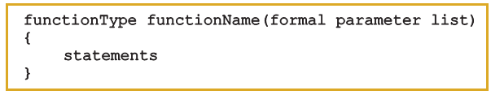
Syntax: Value-Returning Function
Syntax:
functionType is also called the data type or return type

Slide 15
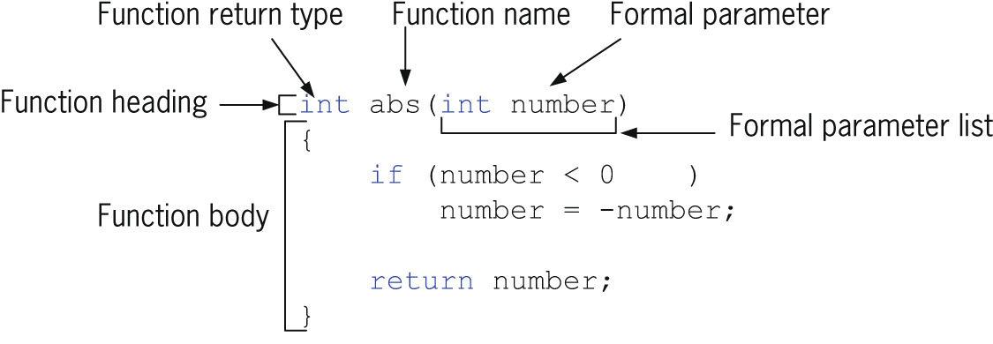

Syntax: Formal Parameter List

Slide 16

Function Call
Syntax to call a value-returning function:

Slide 17


Syntax: Actual Parameter List
Syntax of the actual parameter list:
Formal parameter list can be empty:
A call to a value-returning function with an empty formal parameter list is:

Slide 18
return Statement
Function returns its value via the return statement
It passes this value outside the function

Slide 19

Syntax: return Statement
Syntax:
In C++, return is a reserved word
When a return statement executes
Function immediately terminates
Control goes back to the caller
When a return statement executes in the function main, the program terminates

Slide 20
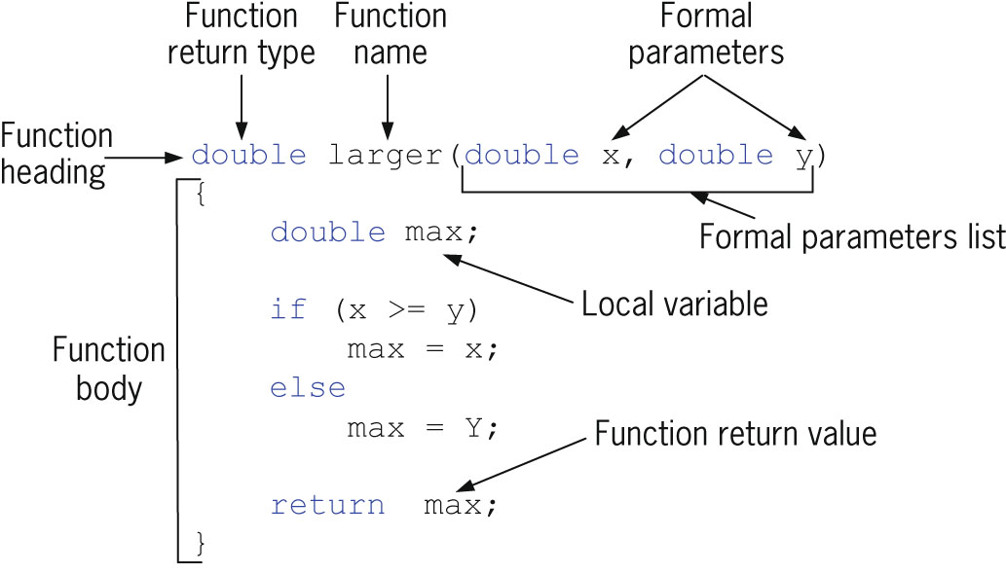
Syntax: return Statement (cont’d.)

Slide 21
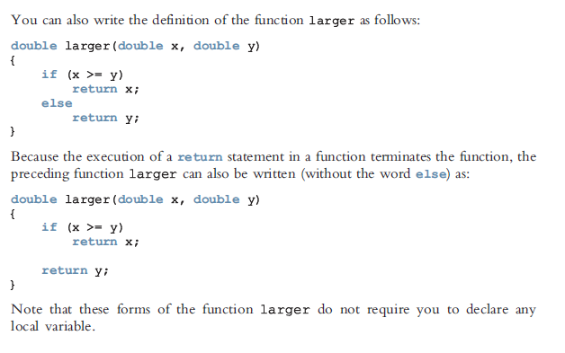

Slide 22
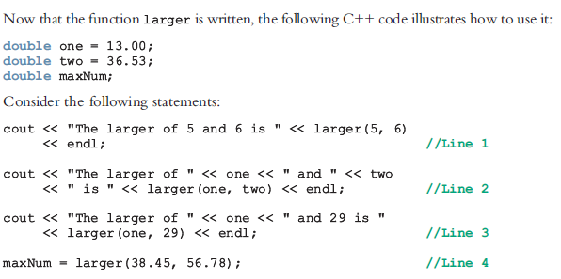

Slide 23
x = larger(int one, 29); //illegal
y = larger(int one, int 29); //illegal
cout << larger(int one, int two); //illegal

Slide 24
double compareThree(double x, double y, double z)
{
return larger(x, larger(y, z));
}

Slide 25

Function Prototype
Function prototype: function heading without the body of the function
Syntax:
Not necessary to specify the variable name in the parameter list
Data type of each parameter must be specified

Slide 26
Flow of Execution
Execution always begins at the first statement in the function main
Other functions are executed only when called
Function prototypes appear before any function definition
Compiler translates these first
Compiler can then correctly translate a function call

Slide 27
Flow of Execution (cont’d.)
Function call transfers control to the first statement in the body of the called function
When the end of a called function is executed, control is passed back to the point immediately following the function call
Function’s returned value replaces the function call statement

Slide 28
Examples
Function calculate the sum
…
…
…

Slide 29
Void Functions
User-defined void functions can be placed either before or after the function main
If user-defined void functions are placed after the function main
The function prototype must be placed before the function main
Void function does not have a return type
return statement without any value is typically used to exit the function early

Slide 30
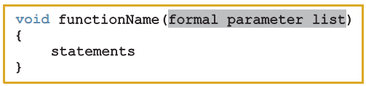
Void Functions (cont’d.)
Formal parameters are optional
A call to a void function is a stand-alone statement
Void function definition syntax:

Slide 31

Void Functions (cont’d.)
Formal parameter list syntax:
Function call syntax:
Actual parameter list syntax:

Slide 32
void sum(int x, int y)
{
cout<<"sum="<<x+y;
}
int main()
{
int a = 2, b=4;
sum(a,b);
return 0;
}

Slide 33
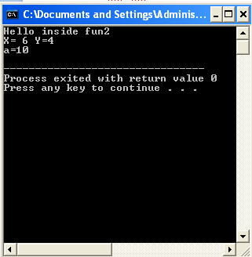
void fun(int , int );
void fun2( );
void fun3(int );
int main()
{
int a = 2, b=4;
fun2();
fun(a+b,b);
fun3(10);
fun3(-a);
cout<<"Good Bye";
return 0;
}
void fun(int x , int y )
{
cout<<"X= "<<x<<" Y="<<y<<endl;
}
void fun2( )
{
cout<<"Hello inside fun2\n";
}
void fun3(int a )
{
if(a<0)
return;
cout<<"a="<<a<<endl;
}

Slide 34
Scope of an Identifier
Scope of an identifier: where in the program the identifier is accessible
Local identifier: identifiers declared within a function (or block)
Global identifier: identifiers declared outside of every function definition
C++ does not allow nested functions
Definition of one function cannot be included in the body of another function

Slide 35
Scope of an Identifier (cont’d.)
Rules when an identifier is accessed:
Global identifiers are accessible by a function or block if:
Declared before function definition
Function name different from identifier
Parameters to the function have different names
All local identifiers have different names

Slide 36
Scope of an Identifier (cont’d.)
Rules when an identifier is accessed (cont’d.):
Nested block
Identifier accessible from declaration to end of block in which it is declared
Within nested blocks if no identifier with same name exists
Scope of function name similar to scope of identifier declared outside any block
i.e., function name scope = global variable scope

Slide 37
Book page 388

Slide 38
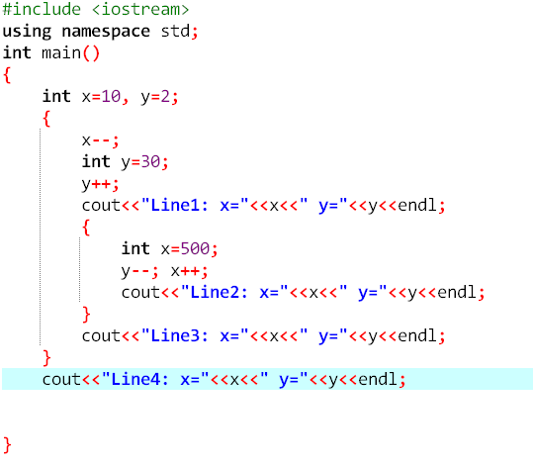
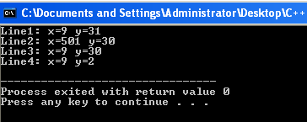
Notes:
#include <iostream>
using namespace std;
int main()
{
int x=10, y=2;
{
x--;
int y=30;
y++;
cout<<"Line1: x="<<x<<" y="<<y<<endl;
{
int x=500;
y--; x++;
cout<<"Line2: x="<<x<<" y="<<y<<endl;
}
cout<<"Line3: x="<<x<<" y="<<y<<endl;
}
cout<<"Line4: x="<<x<<" y="<<y<<endl;
}

Slide 39
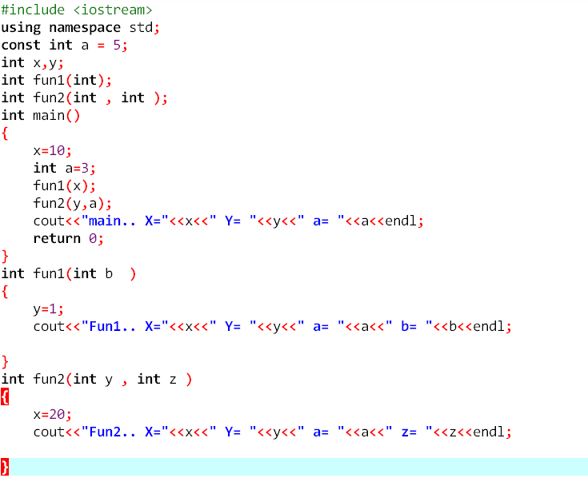
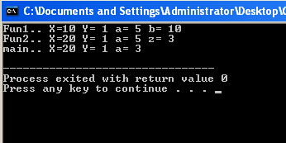

Slide 40
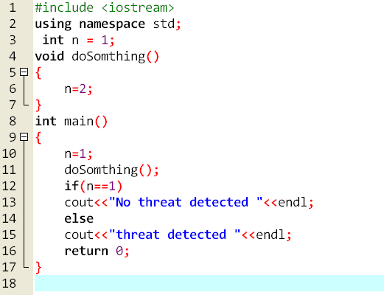
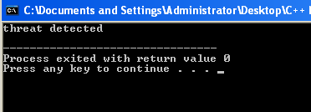

Slide 41
Global Variables, Named Constants, and Side Effects
Using global variables causes side effects
A function that uses global variables is not independent
If more than one function uses the same global variable:
Can be difficult to debug problems with it
Problems caused in one area of the program may appear to be from another area
Global named constants have no side effects
Notes:
#include <iostream>
using namespace std;
const int a = 5;
int x,y;
int fun1(int);
int fun2(int , int );
int main()
{
x=10;
int a=3;
fun1(x);
fun2(y,a);
cout<<"main.. X="<<x<<" Y= "<<y<<" a= "<<a<<endl;
return 0;
}
int fun1(int b )
{
y=1;
cout<<"Fun1.. X="<<x<<" Y= "<<y<<" a= "<<a<<" b= "<<b<<endl;
}
int fun2(int y , int z )
{
x=20;
cout<<"Fun2.. X="<<x<<" Y= "<<y<<" a= "<<a<<" z= "<<z<<endl;
}

Slide 42
Void Functions (cont’d.)
Value parameter: a formal parameter that receives a copy of the content of corresponding actual parameter
Reference parameter: a formal parameter that receives the location (memory address) of the corresponding actual parameter

Slide 43
Value Parameters
If a formal parameter is a value parameter:
The value of the corresponding actual parameter is copied into it
Formal parameter has its own copy of the data
During program execution
Formal parameter manipulates the data stored in its own memory space
Example ….(void, print after and before calling)

Slide 44
#include <iostream>
using namespace std;
void val(int);
int main()
{
int x=1;
cout<<"befor calling.. x="<<x<<endl;
val(x);
cout<<"after calling.. x="<<x<<endl;
}
void val(int x)
{
x=10;
}

Slide 45
Void func_name(dataType &);
Main()
{
--------
}
Void func_name(dataType & Par_name);

Slide 46
Example1
#include <iostream>
using namespace std;
void ref(int &);
int main()
{
int x=1;
cout<<"befor calling.. x="<<x<<endl;
ref(x);
cout<<"after calling.. x="<<x<<endl;
}
void ref(int & i)
{
i=10;
}

Slide 47
Exapmle2
#include <iostream>
using namespace std;
void fun(int x,int & pre,int & next)
{
pre=x-1;
next=x+1;
}
int main()
{
int x=100,y,z;
fun(x,y,z);
cout<<"previous of x="<<y<<endl;
cout<<"next of x="<<z<<endl;
}

Slide 48
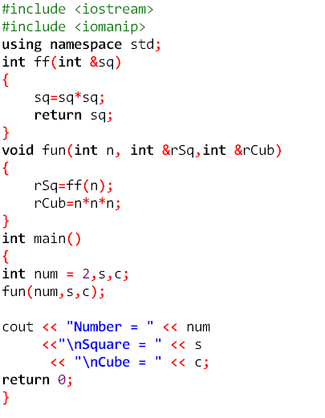

Notes:
#include <iostream>
#include <iomanip>
using namespace std;
int ff(int &sq)
{
sq=sq*sq;
return sq;
}
void fun(int n, int &rSq,int &rCub)
{
rSq=ff(n);
rCub=n*n*n;
}
int main()
{
int num = 2,s,c;
fun(num,s,c);
cout << "Number = " << num
<<"\nSquare = " << s
<< "\nCube = " << c;
return 0;
}

Slide 49
Reference Variables as Parameters
If a formal parameter is a reference parameter
It receives the memory address of the corresponding actual parameter
During program execution to manipulate data
Changes to formal parameter will change the corresponding actual parameter

Slide 50
Reference Variables as Parameters (cont'd.)
Reference parameters are useful in three situations:
Returning more than one value
Changing the actual parameter
When passing the address would save memory space and time

Slide 51
Value and Reference Parameters and Memory Allocation
When a function is called
Memory for its formal parameters and its local variables is allocated in the function data area
For a value parameter, the actual parameter’s value is copied into the formal parameter’s memory cell
Changes to the formal parameter do not affect the actual parameter’s value

Slide 52
Value and Reference Parameters and Memory Allocation (cont’d.)
For a reference parameter, the actual parameter’s address passes to the formal parameter
Both formal and actual parameters refer to the same memory location
During execution, changes made to the formal parameter’s value permanently change the actual parameter’s value

Slide 53
Reference Parameters and Value-Returning Functions
Can also use reference parameters in a value-returning function
Not recommended
By definition, a value-returning function returns a single value via return statement
If a function needs to return more than one value, change it to a void function and use reference parameters to return the values

Slide 54
Function Overloading: An Introduction
In a C++ program, several functions can have the same name
Function overloading: creating several functions with the same name
Function signature: the name and formal parameter list of the function
Does not include the return type of the function

Slide 55
void functionOne(int x)
void functionTwo(int x, double y)
void functionThree(double y, int x)
int functionFour(char ch, int x, double y)
int functionFive(char ch, int x, string name)
→ These functions all have different formal parameter lists.

Slide 56
void functionSix(int x, double y, char ch)
void functionSeven(int one, double u, char firstCh)
→ these functions have the same formal parameter list.

Slide 57
Function Overloading (cont’d.)
Two functions are said to have different formal parameter lists if both functions have either:
A different number of formal parameters
If the number of formal parameters is the same, but the data type of the formal parameters differs in at least one position
Overloaded functions must have different function signatures

Slide 58
the following function headings correctly overload the function functionXYZ:
void functionXYZ()
void functionXYZ(int x, double y)
void functionXYZ(double one, int y)
void functionXYZ(int x, double y, char ch)

Slide 59
void functionABC(int x, double y)
int functionABC(int x, double y)
→ Both of these function headings have the same name and same formal parameter list. Therefore, these function headings to overload the function functionABC are incorrect.
In this case, the compiler will generate a syntax error. (Notice that the return types of these function headings are different.)

Slide 60
int largerInt(int x, int y);
char largerChar(char first, char second);
double largerDouble(double u, double v);
string largerString(string first, string second);
Using overloading:
int larger(int x, int y);
char larger(char first, char second);
double larger(double u, double v);
string larger(string first, string second);

Slide 61
Function Overloading (cont’d.)
The parameter list supplied in a call to an overloaded function determines which function is executed

Slide 62
Functions with Default Parameters
In a function call, the number of actual and formal parameters must be the same
C++ relaxes this condition for functions with default parameters
Can specify the value of a default parameter in the function prototype
If you do not specify the value for a default parameter when calling the function, the default value is used

Slide 63
Functions with Default Parameters (cont’d.)
All default parameters must be the rightmost parameters of the function
If a default parameter value is not specified:
You must omit all of the arguments to its right
Default values can be constants, global variables, or function calls
Cannot assign a constant value as a default value to a reference parameter

Slide 64
void funcExp(int x, int y, double t, char z = 'A', int u = 67, char v = 'G', double w = 78.34);
Suppose you have the following statements:
int a, b; char ch; double d;
The following function calls are legal:
1. funcExp(a, b, d);
2. funcExp(a, 15, 34.6, 'B', 87, ch);
3. funcExp(b, a, 14.56, 'D');
In statement 1, the default values of z, u, v, and w are used.
In statement 2, the default value of z is replaced by 'B', the default alue of u is replaced by 87, the default value of v is replaced by the value of ch, and the default value of w is used.
In statement 3, the default value of z is replaced by 'D', and the default values of u, v, and w are used.

Slide 65
The following function calls are illegal:
1. funcExp(a, 15, 34.6, 46.7);
2. funcExp(b, 25, 48.76, 'D', 4567, 78.34);
In statement 1, because the value of z is omitted, all other default values must be omitted.
In statement 2, because the value of v is omitted, the value of w should be omitted, too.

Slide 66
The following are illegal function prototypes with default parameters:
1. void funcOne(int x, double z = 23.45, char ch, int u = 45);
2. int funcTwo(int length = 1, int width, int height = 1);
3. void funcThree(int x, int& y = 16, double z = 34);
In statement 1, because the second parameter z is a default parameter, all other parameters after z must be default parameters.
In statement 2, because the first parameter is a default parameter, all parameters must be the default parameters.
In statement 3, a constant value cannot be assigned to y because y is a reference parameter.

Slide 67
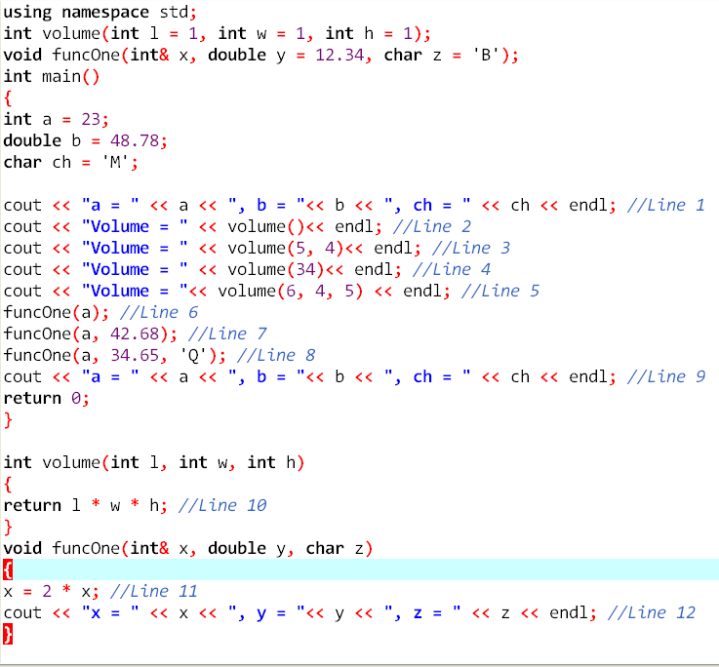
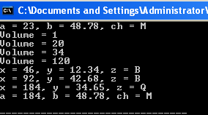
Notes:
#include <iostream>
#include <iomanip>
using namespace std;
int volume(int l = 1, int w = 1, int h = 1);
void funcOne(int& x, double y = 12.34, char z = 'B');
int main()
{
int a = 23;
double b = 48.78;
char ch = 'M';
cout << "a = " << a << ", b = "<< b << ", ch = " << ch << endl; //Line 1
cout << "Volume = " << volume()<< endl; //Line 2
cout << "Volume = " << volume(5, 4)<< endl; //Line 3
cout << "Volume = " << volume(34)<< endl; //Line 4
cout << "Volume = "<< volume(6, 4, 5) << endl; //Line 5
funcOne(a); //Line 6
funcOne(a, 42.68); //Line 7
funcOne(a, 34.65, 'Q'); //Line 8
cout << "a = " << a << ", b = "<< b << ", ch = " << ch << endl; //Line 9
return 0;
}
int volume(int l, int w, int h)
{
return l * w * h; //Line 10
}
void funcOne(int& x, double y, char z)
{
x = 2 * x; //Line 11
cout << "x = " << x << ", y = "<< y << ", z = " << z << endl; //Line 12
}

Slide 68
Recursion

Slide 69
Recursive Definitions
Recursion: solving a problem by reducing it to smaller versions of itself
Provides a powerful way to solve certain problems which would be complicated otherwise

Slide 70
Recursive Definitions (cont’d.)
Recursive definition: defining a problem in terms of a smaller version of itself
Base case: the case for which the solution is obtained directly
Every recursive definition must have one (or more) base case(s)
The base case stops the recursion
General case: must eventually reduce to a base case

Slide 71
Recursive Definitions (cont’d.)
Example: factorials
0! = 1 (1)
n! = n x (n-1)! if n > 0 (2)
Equation (1) is called the base case
Equation (2) is called the general case

Slide 72
Recursive Definitions (cont’d.)
From the previous example (factorial), it is clear that:
1. Every recursive definition must have one (or more) base cases.
2. The general case must eventually be reduced to a base case.
3. The base case stops the recursion.

Slide 73
Recursive Definitions (cont'd.)
Recursive algorithm: finds a solution by reducing problem to smaller versions of itself
Must have one (or more) base cases
General solution must eventually reduce to a base case
Recursive function: a function that calls itself
Recursive algorithms are implemented using recursive functions

Slide 74
Recursive Definitions (cont’d.)
Think of a recursive function as having infinitely many copies of itself
Every call has its own code and its own set of parameters and local variables
After completing a particular recursive call:
Control goes back to the calling environment, the previous call
Execution begins from the point immediately following the recursive call

Slide 75
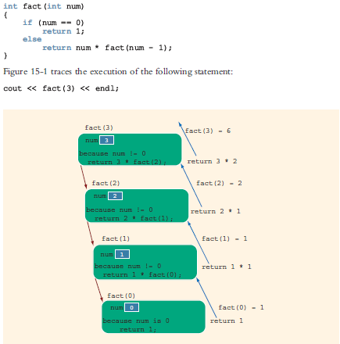
Output
6

Slide 76
Infinite Recursion
Infinite recursion: every recursive call results in another recursive call
In theory, infinite recursion executes forever
Because computer memory is finite:
Function executes until the system runs out of memory
Results in an abnormal program termination

Slide 77
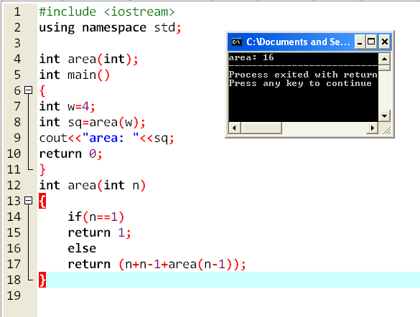
Notes:
#include <iostream>
using namespace std;
int area(int);
int main()
{
int w=4;
int sq=area(w);
cout<<"area: "<<sq;
return 0;
}
int area(int n)
{
if(n==1)
return 1;
else
return (n+n-1+area(n-1));
}

Slide 78
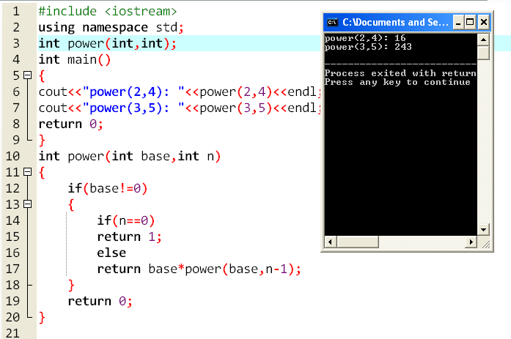
Notes:
#include <iostream>
using namespace std;
int power(int,int);
int main()
{
cout<<"power(2,4): "<<power(2,4)<<endl;
cout<<"power(3,5): "<<power(3,5)<<endl;
return 0;
}
int power(int base,int n)
{
if(base!=0)
{
if(n==0)
return 1;
else
return base*power(base,n-1);
}
return 0;
}

Slide 79
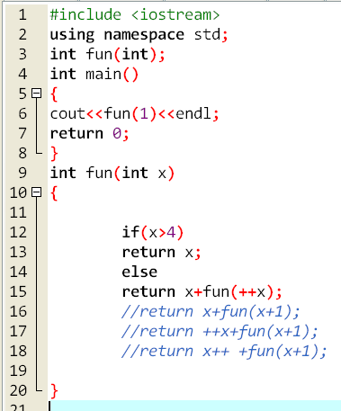




Notes:
#include <iostream>
using namespace std;
int fun(int);
int main()
{
cout<<fun(1)<<endl;
return 0;
}
int fun(int x)
{
if(x>4)
return x;
else
return x+fun(++x);
//return x+fun(x+1);
//return ++x+fun(x+1);
//return x++ +fun(x+1);
}

Slide 80
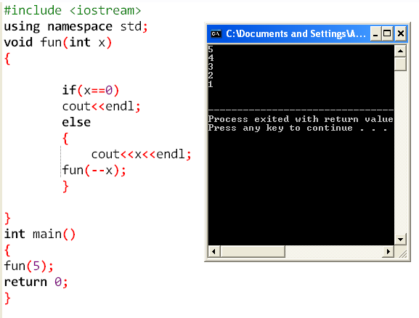
Notes:
#include <iostream>
using namespace std;
void fun(int x)
{
if(x==0)
cout<<endl;
else
{
cout<<x<<endl;
fun(--x);
}
}
int main()
{
fun(5);
return 0;
}

Slide 81
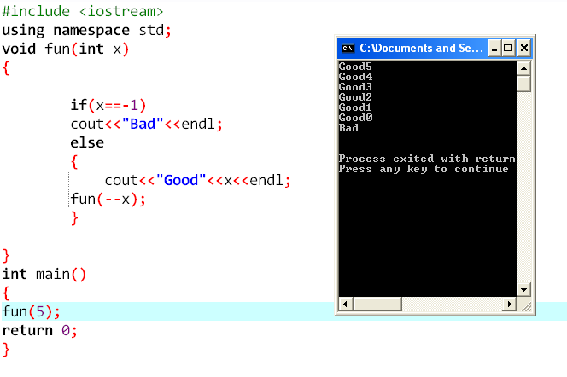

Slide 82
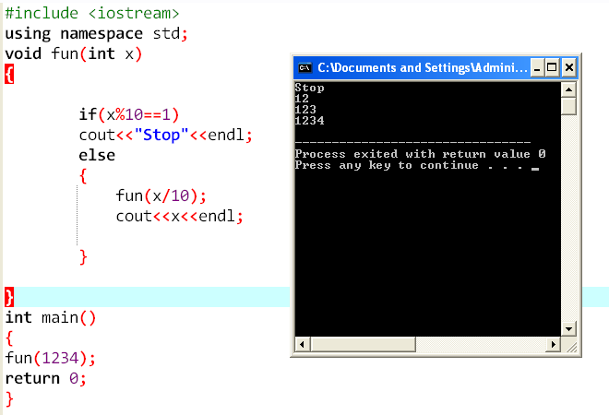
Notes:
#include <iostream>
using namespace std;
void fun(int x)
{
if(x%10==1)
cout<<"Stop"<<endl;
else
{
fun(x/10);
cout<<x<<endl;
}
}
int main()
{
fun(1234);
return 0;
}

Slide 83
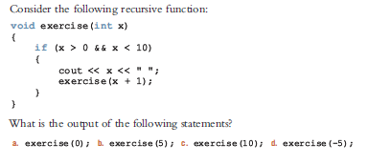

Slide 84
Write a recursive function named sumSquares that returns the sum of the squares of the numbers from 0 to num, in which num is a nonnegative int variable. Do not use global variables; use the appropriate parameters. Also write a program to test your function.
Notes:
#include <iostream>
using namespace std;
void sumSquares(int& sum, int num);
int main()
{
int num;
int sum;
cout << "Enter a nonnegative integer: ";
cin >> num;
cout << endl;
sum = 0;
sumSquares(sum, num);
cout << "The sum of the squares of the numbers from 0 to " << num
<< " = " << sum << endl;
return 0;
}
void sumSquares(int& sum, int num)
{
if (num >= 0)
{
sum = sum + num * num;
sumSquares(sum, num - 1);
}
}

Slide 85
Infinite Recursion (cont’d.)
To design a recursive function:
Understand problem requirements
Determine limiting conditions
Identify base cases and provide a direct solution to each base case
Identify general cases and provide a solution to each general case in terms of smaller versions of itself

Slide 86
Recursion or Iteration?
Iterative control structure: uses a loop to repeat a set of statements
There are usually two ways to solve a particular problem:
Iteration (looping)
Recursion
When choosing, must consider:
Nature of the problem
Efficiency

Slide 87
Recursion or Iteration? (cont’d.)
Whenever a function is called
Memory space for its formal parameters and (automatic) local variables is allocated
When the function terminates
That memory space is then deallocated
Every (recursive) call has its own set of parameters and (automatic) local variables

Slide 88
Recursion or Iteration? (cont’d.)
Overhead associated with executing a (recursive) function in terms of:
Memory space
Computer time
A recursive function executes more slowly than its iterative counterpart
Today’s computers are fast
Overhead of a recursion function is not noticeable

Slide 89
Recursion or Iteration? (cont’d.)
Sometimes iterative solution is more obvious and easier to understand
If the definition of a problem is inherently recursive, consider a recursive solution

